Slide 1
CS584 Machine Learning
Lecture 19. Unsupervised Learning
Oleksandr Narykov
onarykov@iit.edu

Slide 2

Class Project
Team effort, 2-3 people. Teams of one are possible, but prior discussion is needed
Recommended data source – Kaggle
Consider necessary compute time!
Timeline:
Oct 26 – teams are formed, dataset selected and registration spreadsheet filled
https://docs.google.com/spreadsheets/d/10MJH1GuE4USLNtRfGlrkqTPTciY0JMwpNkR-6XhP0p8/edit?usp=sharing
Nov 14,16 – Interim project review. Short 3-min presentation about your progress
Nov 30 – Final report is due. Approximately 5 pages + code in a publicly accessible git repository. Link should be included in the report document
39

Slide 3
Unsupervised Learning

Slide 4
Motivation
There is no supervision – i.e., there is no target variable
Find groups / clusters in the data
2

Slide 5
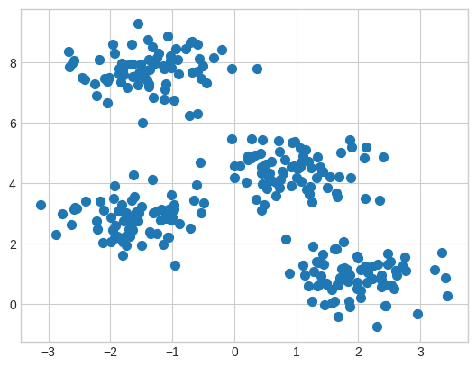
Clustering
Intuitively, clusters are the groups in the data for which points within the same group are more similar than the points from different groups
Mathematically, groups
of points are usually con-
sidered clusters when they
Form high-density regions
in a data space
2

Slide 6
Various Approaches
K-Means
Expectation Maximization (EM)
EM is a general approach that can be used for many
other tasks, one of which is clustering
Hierarchical clustering
DBScan
Spectral clustering
Mean-shift
… and many more
3

Slide 7
We’ll Cover
K-Means
EM for mixture of Gaussians
Spectral clustering
4

Slide 8
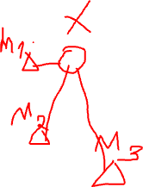
K-Means
Basic idea: given data, find k prototype vectors, and assign each data point to its closest prototype vector, such that the sum of the distances to the closest prototype vectors is minimized
𝑁
𝑗=1
Let 𝐷 = 𝑥
𝑘
𝑖=1
be the data and let 𝑚
be the
𝑗
𝑖
prototype vectors. Objective:
minimize ∑^{𝑁} min 𝑑𝑖𝑠𝑡𝑎𝑛𝑐𝑒 𝑥_{𝑗}, 𝑚_{𝑖}
𝑗=1
𝑖
A typical distance metric is Euclidan distance
5

Slide 9
K-Means
Initialize k centers 𝑚_{𝑖}
𝑘
𝑖=1
Repeat until convergence
Assign each data point 𝑥_{𝑗} to the closest cluster center
Re-compute each center 𝑚_{𝑖}
𝑘
𝑖=1
as the mean of the
points that are assigned to that center
6

Slide 10
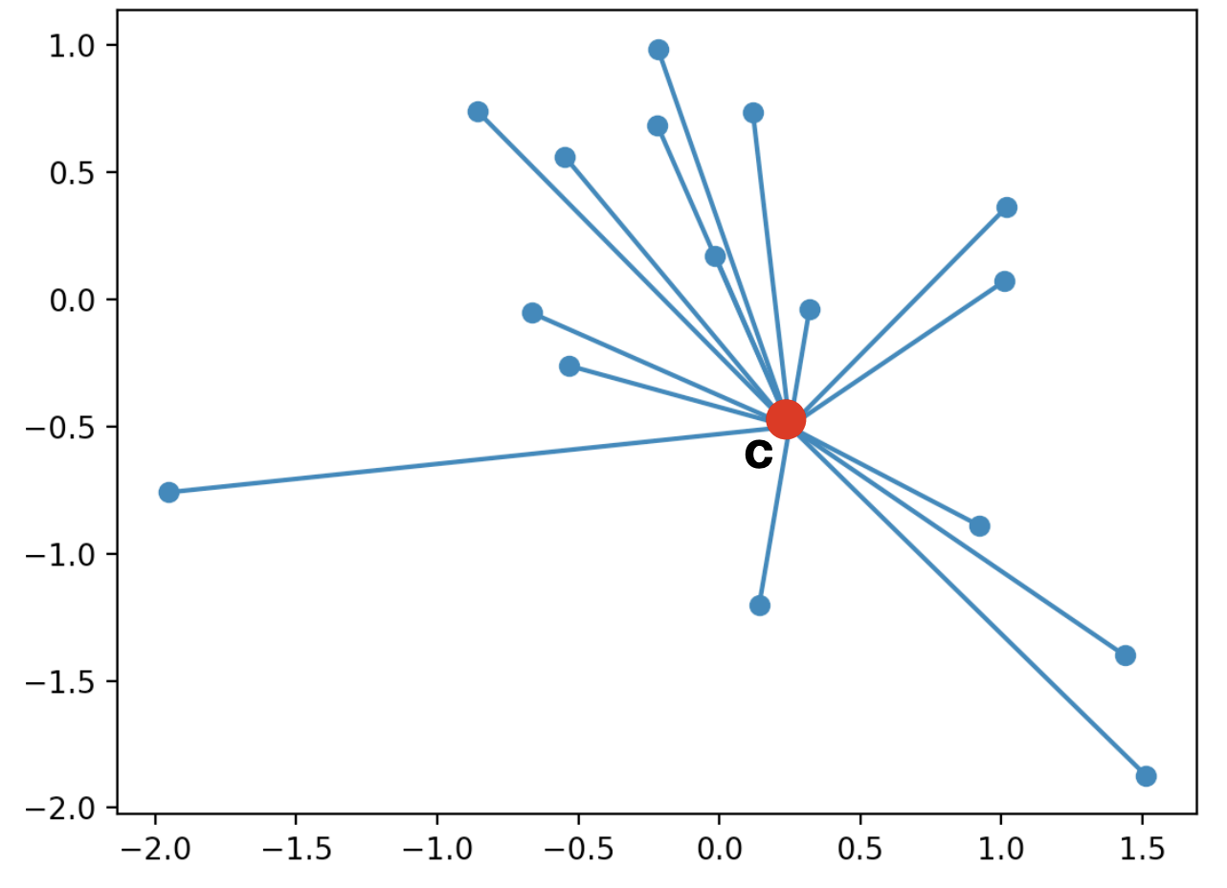
K-Means
Cluster centroid
6

Slide 11
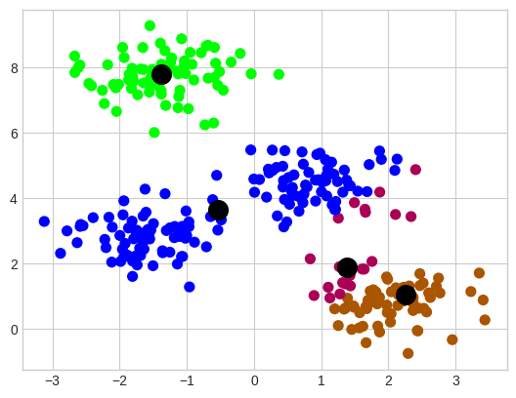
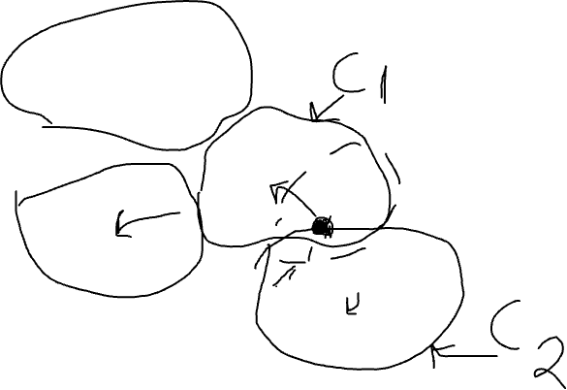
K-Means
Randomly initialized cluster centers
6

Slide 12
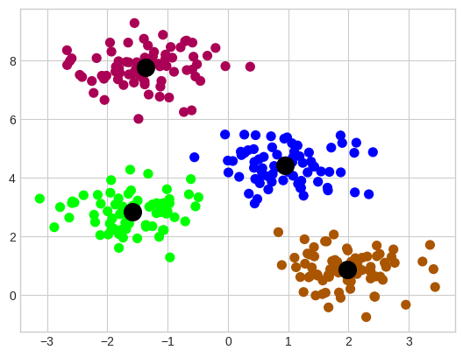
K-Means
Algorithm output after convergence (colors are changed)
6

Slide 13
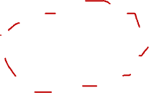
K-Means
Algorithm output after convergence (colors are changed)
6

Slide 14
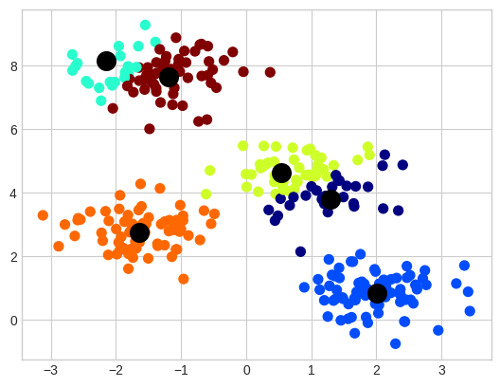
K-Means
Output of the K-Means with 6 clusters
6

Slide 15
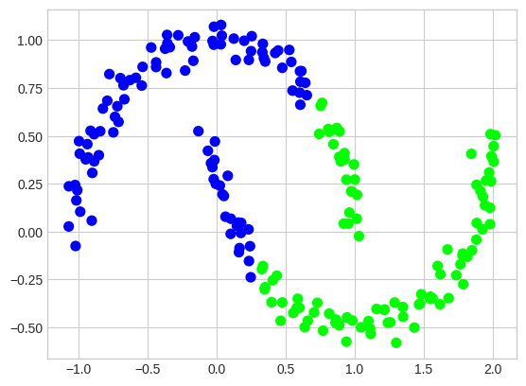
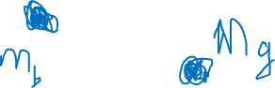
K-Means
Important assumption – clusters are convex
6

Slide 16
K-Means Summary
Requires specifying the number of clusters beforehand
No guarantee for convergence to the global minimum
Output is highly dependent on the initial centroids
Sometimes, clusters can become empty
6

Slide 17
EM for Mixture of Gaussians
Basic idea: very much like the Bayes classifier where we have P(C) and p(x|C) and we use that for computing P(C|x), except, in this case, classes are not given to us. So, we take an iterative approach
Repeat until convergence
Assign data points to classes/centers/components, probabilistically (i.e., compute P(C|x) using P(C) and p(x|C) ) – Expectation
Re-estimate class/center/component parameters based on the probabilistic assignments to classes/centers (i.e., recompute P(C) and p(x|C) using the probabilistic assignments) – Maximization
7

Slide 18
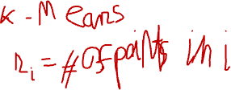
Notation
𝑃 𝐶_{𝑖} : prior probability of component 𝐶_{𝑖}
A multinomial distribution
𝑃 𝑥_{𝑗} 𝐶_{𝑖} : probability that component 𝐶_{𝑖} generated 𝑥_{𝑗}
A Gaussian distribution with mean 𝜇_{𝑖} and variance 𝜎²
𝑖
This can be easily generalized to multivariate Gaussian distribution with mean 𝜇_{𝑖} and co-variance Σ_{𝑖}
𝑃 𝐶_{𝑖} 𝑥_{𝑗} : probability that 𝑥_{𝑗} belongs to component 𝐶_{𝑖}
Via Bayes rule, 𝑃 𝐶_{𝑖} 𝑥_{𝑗} ∝ 𝑃 𝑥_{𝑗} 𝐶_{𝑖} 𝑃 𝐶_{𝑖}
𝑛_{𝑖}: Expected number of instances that belong to component 𝐶_{𝑖}
𝑛_{𝑖} = ∑^{𝑁} 𝑃 𝐶_{𝑖} 𝑥_{𝑗}
𝑗=1
8

Slide 19
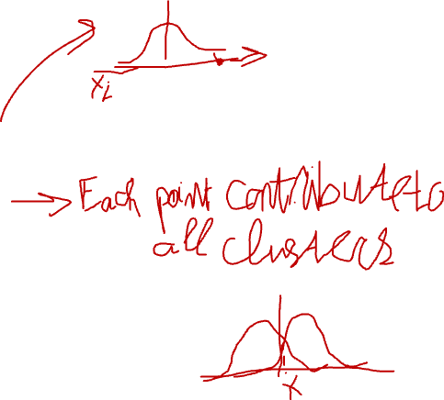
EM
E step: compute cluster/component assignments
𝑃 𝐶_{𝑖} 𝑥_{𝑗} ∝ 𝑃 𝑥_{𝑗} 𝐶_{𝑖} 𝑃 𝐶_{𝑖}
M step: recompute parameters
𝑛_{𝑖} = ∑^{𝑁} 𝑃 𝐶_{𝑖} 𝑥_{𝑗}
𝑗=1
Weighted counts, where weights are 𝑃 𝐶_{𝑖} 𝑥_{𝑗}
𝑃 𝐶
₌ 𝑛_{𝑖}
𝑖
𝑁
𝑃 𝑥_{𝑗} 𝐶_{𝑖} ∼ Ν 𝜇_{𝑖}, 𝜎²
𝑖
∑𝑁
𝑃 𝐶 𝑥 𝑥_{𝑗}
𝜇_{𝑖} =
𝑗=1
𝑖 𝑗
𝑛
𝑖
Weighted mean, where weights are 𝑃 𝐶_{𝑖} 𝑥_{𝑗}
2
∑𝑁
𝑃 𝐶 𝑥 𝑥 −𝑚
𝑗=1
𝑖 𝑗
𝑗 𝑖
𝜎 ² =
𝑖
𝑛_{𝑖}
9
Weighted variance, where weights are 𝑃 𝐶_{𝑖} 𝑥_{𝑗}

Slide 20
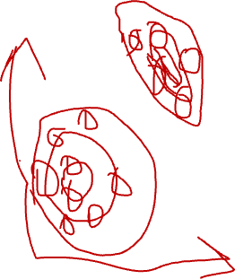
EM
E step: compute cluster/component assignments
𝑃 𝐶_{𝑖} 𝑥_{𝑗} ∝ 𝑃 𝑥_{𝑗} 𝐶_{𝑖} 𝑃 𝐶_{𝑖}
M step: recompute parameters
𝑛_{𝑖} = ∑^{𝑁} 𝑃 𝐶_{𝑖} 𝑥_{𝑗}
𝑗=1
Weighted counts, where weights are 𝑃 𝐶_{𝑖} 𝑥_{𝑗}
𝑃 𝐶
₌ 𝑛_{𝑖}
𝑖
𝑁
𝑃 𝑥_{𝑗} 𝐶_{𝑖} ∼ Ν 𝜇_{𝑖}, 𝜎²
𝑖
∑𝑁
𝑃 𝐶 𝑥 𝑥_{𝑗}
𝜇_{𝑖} =
𝑗=1
𝑖 𝑗
𝑛
𝑖
Weighted mean, where weights are 𝑃 𝐶_{𝑖} 𝑥_{𝑗}
2
∑𝑁
𝑃 𝐶 𝑥 𝑥 −𝑚
𝑗=1
𝑖 𝑗
𝑗 𝑖
𝜎 ² =
𝑖
𝑛_{𝑖}
9
Weighted variance, where weights are 𝑃 𝐶_{𝑖} 𝑥_{𝑗}

Slide 21
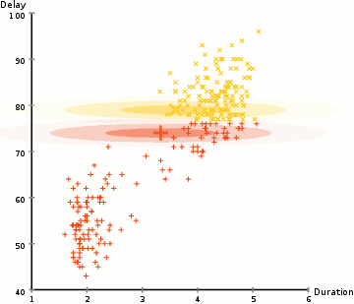
EM
https://upload.wikimedia.org/wikipedia/commons/6/69/EM_Clustering_of_Old_Faithful_data.gif
9

Slide 22
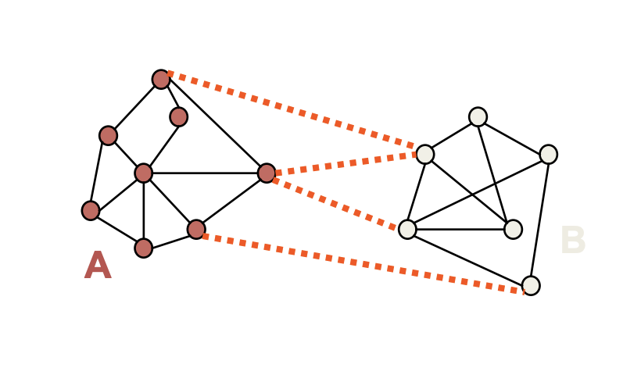
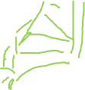
Spectral Clustering
EM and K-Means are limited by data shape assumptions
Potential solution: assign points that are close to each other to the same cluster
9

Slide 23
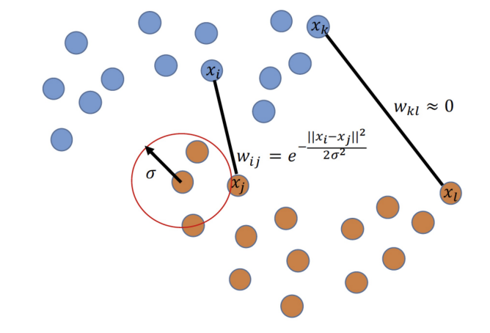
Spectral Clustering
Basic idea: group samples based graph communities
We need to construct a graph over datapoints
Similarity graph with a Gaussian kernel is a common approach
9

Slide 24
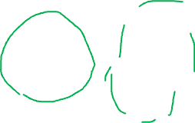
Spectral Clustering
Let’s separate the graph in two parts
Min-cut algorithm
Min-cut
Preferred cut
9

Slide 25
Spectral Clustering
Let’s separate the graph in two parts
Min-cut algorithm
Min-cut
Preferred cut
9

Slide 26
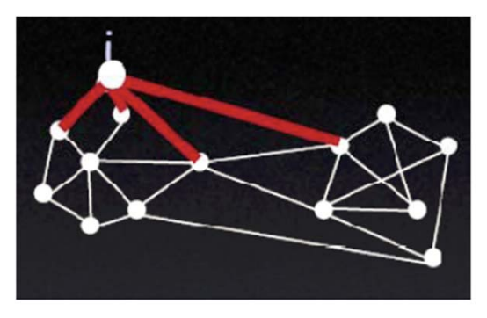
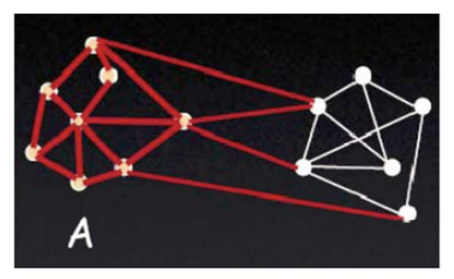
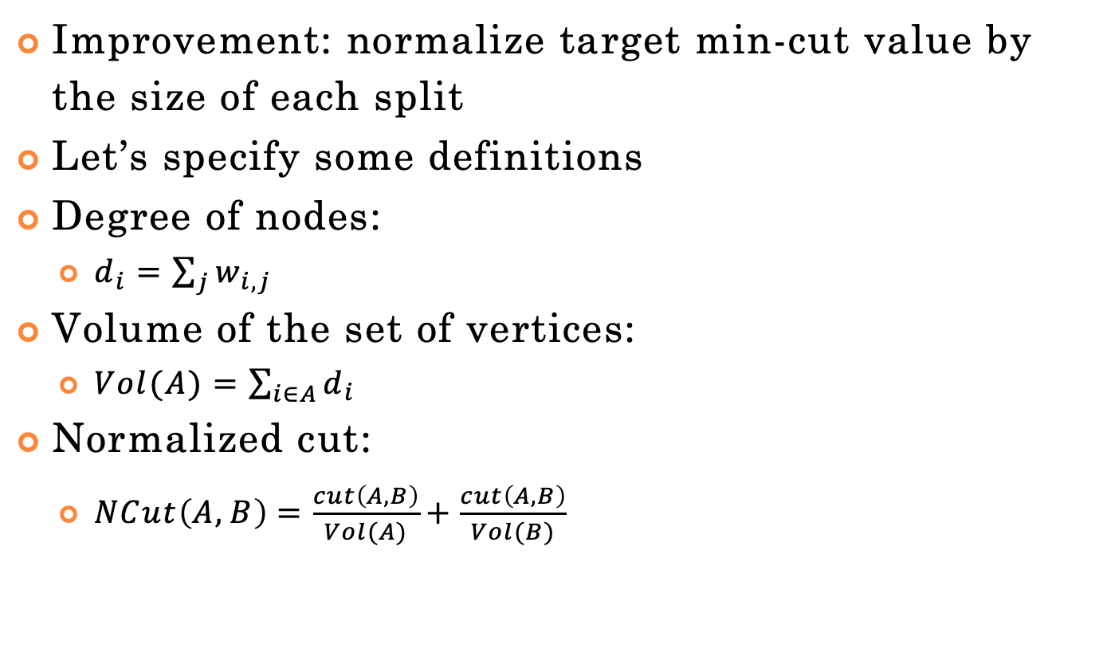
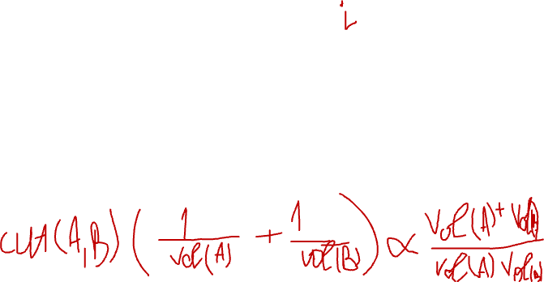
Spectral Clustering
Improvement: normalize target min-cut value by the size of each split
Let’s specify some definitions
Degree of nodes:
$d_{i}=\sum_{j}{w_{i,j}}$
Volume of the set of vertices:
$Vol(A)=\sum_{i∈A}{d_{i}}$
Normalized cut:
$NCut\left(A,B\right)=\frac{cut\left(A,B\right)}{Vol(A)}+\frac{cut\left(A,B\right)}{Vol(B)}$
https://people.csail.mit.edu/dsontag/
9

Slide 27
Spectral Clustering
Improvement: normalize target min-cut value by the size of each split
Let’s specify some definitions
Degree of nodes:
$d_{i}=\sum_{j}{w_{i,j}}$
Volume of the set of vertices:
$Vol(A)=\sum_{i∈A}{d_{i}}$
Normalized cut:
$NCut\left(A,B\right)=\frac{cut\left(A,B\right)}{Vol(A)}+\frac{cut\left(A,B\right)}{Vol(B)}$
https://people.csail.mit.edu/dsontag/
9

Slide 28
Spectral Clustering
Improvement: normalize target min-cut value by the size of each split
Let’s specify some definitions
Degree of nodes:
$d_{i}=\sum_{j}{w_{i,j}}$
Volume of the set of vertices:
$Vol(A)=\sum_{i∈A}{d_{i}}$
Normalized cut:
$NCut\left(A,B\right)=\frac{cut\left(A,B\right)}{Vol(A)}+\frac{cut\left(A,B\right)}{Vol(B)}$
https://people.csail.mit.edu/dsontag/
9

Slide 29
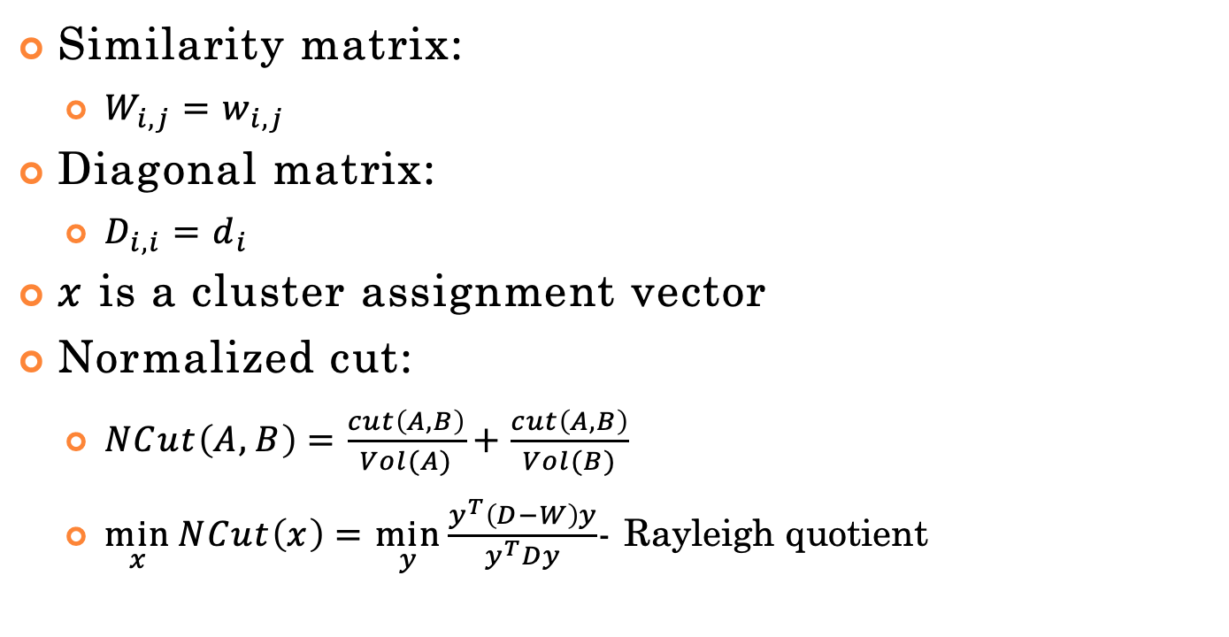
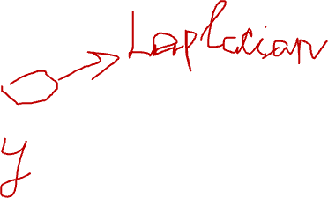
Spectral Clustering
Similarity matrix:
$W_{i,j}=w_{i,j}$
Diagonal matrix:
$x$ is a cluster assignment vector
Normalized cut:
$NCut\left(A,B\right)=\frac{cut\left(A,B\right)}{Vol(A)}+\frac{cut\left(A,B\right)}{Vol(B)}$
$\min_{x}{NCut\left(x\right)}=\min_{y}{\frac{y^{T}\left(D−W\right)y}{y^{T}Dy}}$- Rayleigh quotient
9

Slide 30
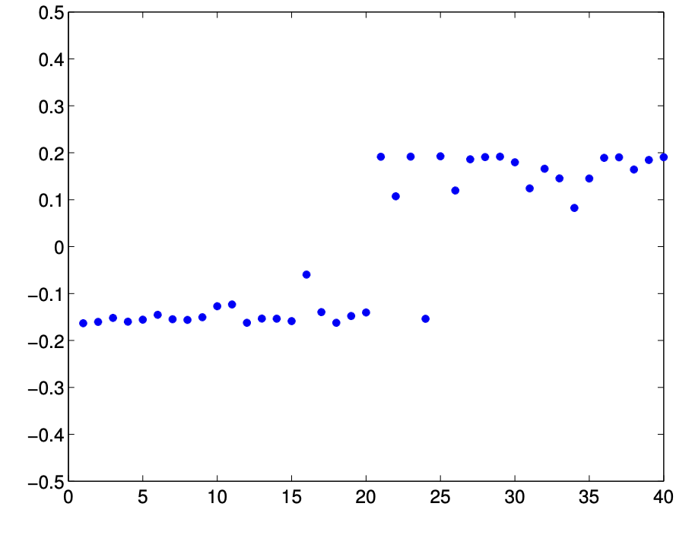
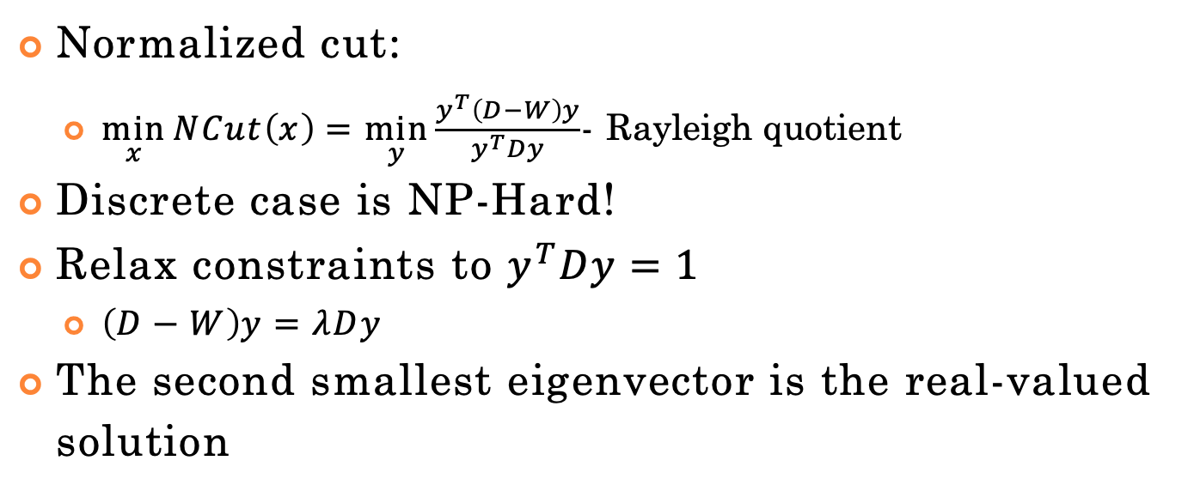
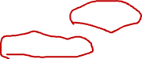
Spectral Clustering
Normalized cut:
$\min_{x}{NCut\left(x\right)}=\min_{y}{\frac{y^{T}\left(D−W\right)y}{y^{T}Dy}}$- Rayleigh quotient
Discrete case is NP-Hard!
Relax constraints to $y^{T}Dy=1$
$\left(D−W\right)y=λDy$
The second smallest eigenvector is the real-valued solution
9

Slide 31
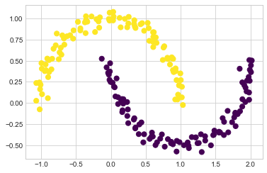
Spectral Clustering
9

Slide 32
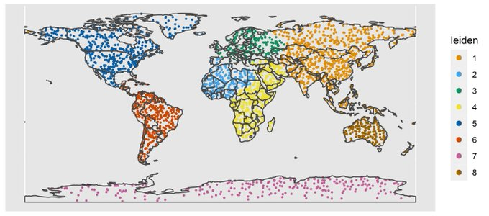
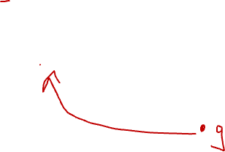
Leiden Clustering Example
https://github.com/lambdamoses/umap_globe
12

Slide 33
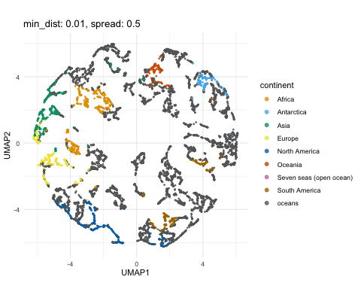
UMAP + Leiden Clustering Example
12
https://github.com/lambdamoses/umap_globe

Slide 34
Scikit-Learn
http://scikit- learn.org/stable/modules/clustering.html
10

